Slide 1
Material-based Fracturing Framework for Destruction
Wayne Wu, Mike Lyndon, Cameron White

Slide 2
Motivations
Challenging to get the nice look
Multi-material, heterogeneous setup
Complicated constraint network to manage
Long iteration time
Art-directable fracturing and destruction
SimpleBullet (ILM, Disney, Pixar)

Slide 3
Design Objectives
Aesthetic: How realistic does the fracturing/destruction look?
Art Directability: How easy to modify based on artistic feedback?
Flexibility: How well does it work with different shapes and sizes?
Functionality: How robust and useful are the features?
Performance: How long it takes to fracture a scene and simulate it?
Extendability: How easy for users to modify and extend the tools?

Slide 4
What have we done (so far)?

Slide 5
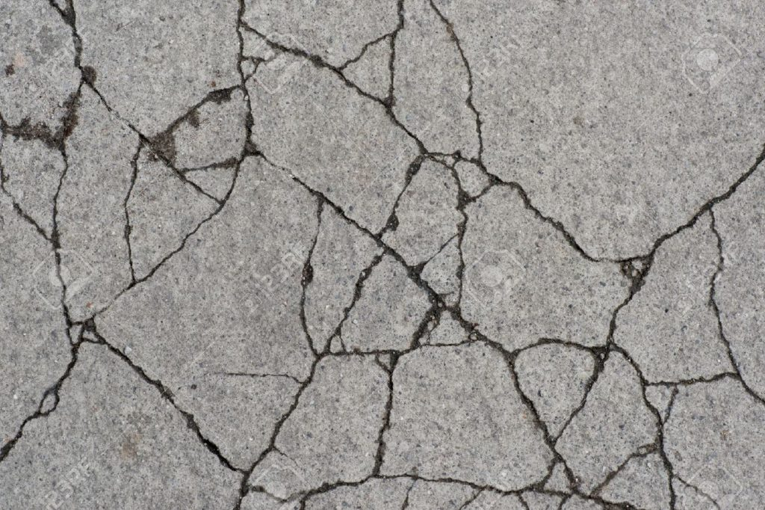
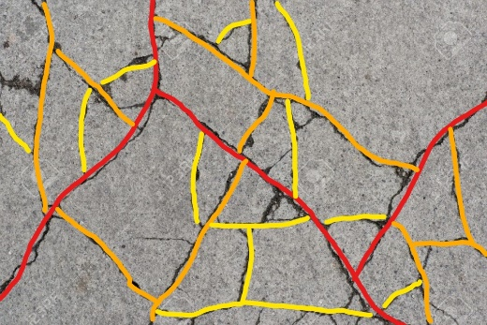
Recursive Fracture

Slide 6
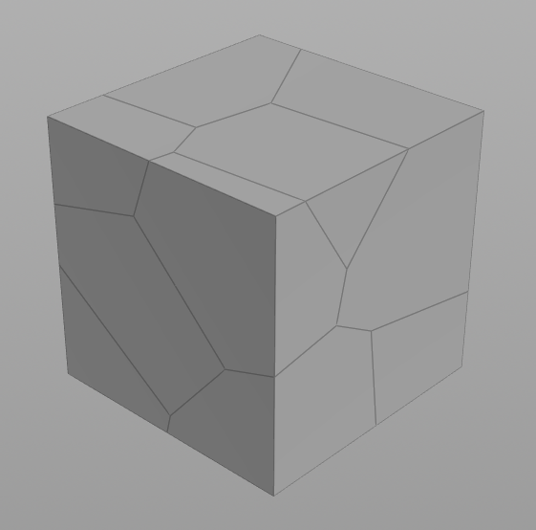
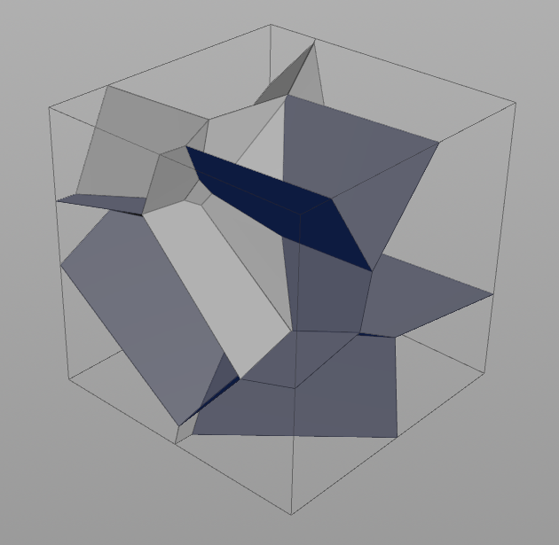
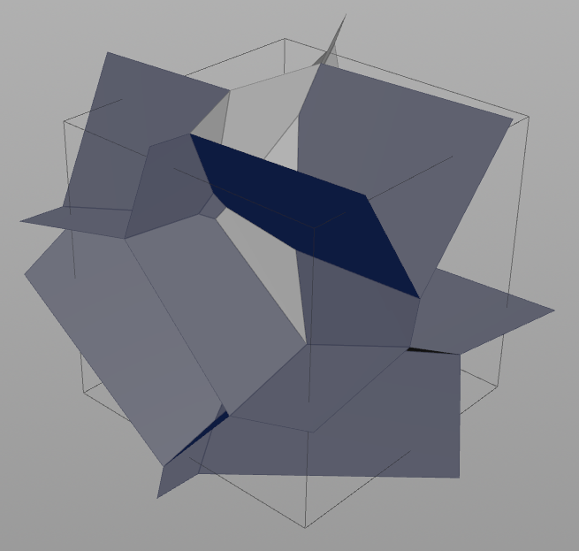
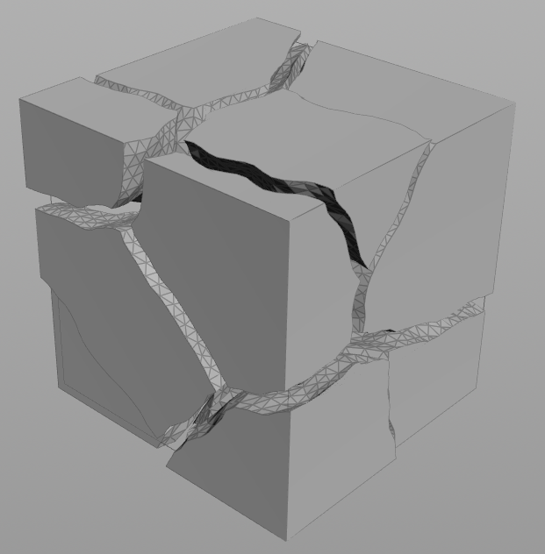
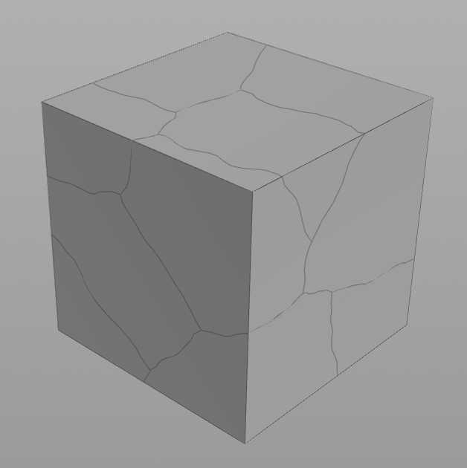
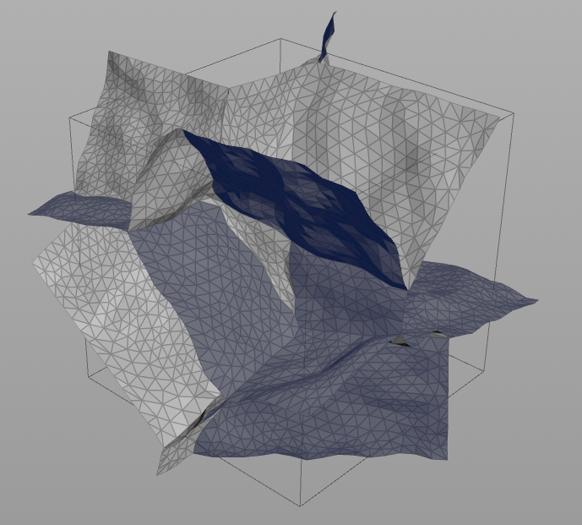
CSG Voronoi
Inside Face
Extrude Out
Exploded
Boolean

Slide 7
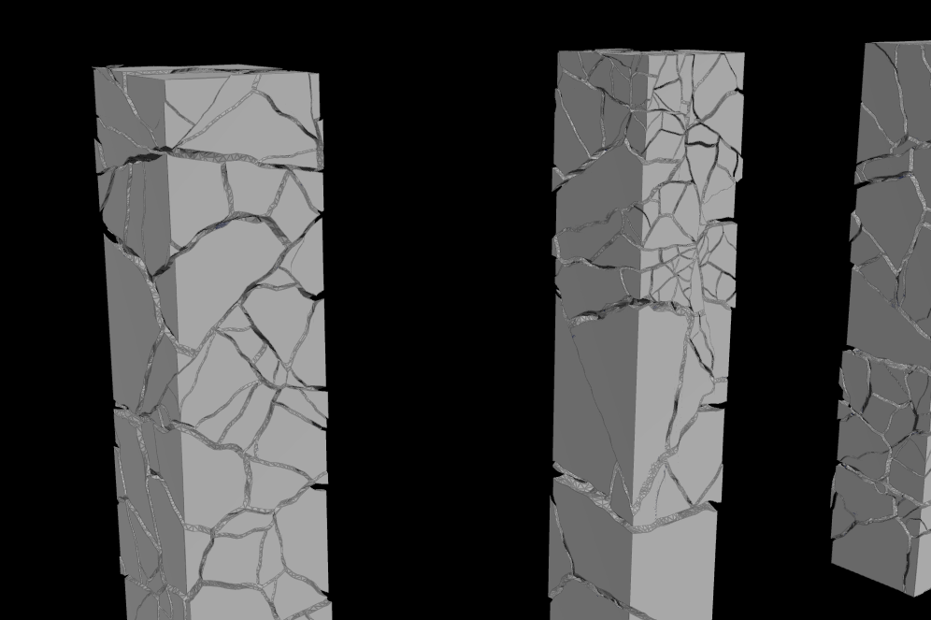
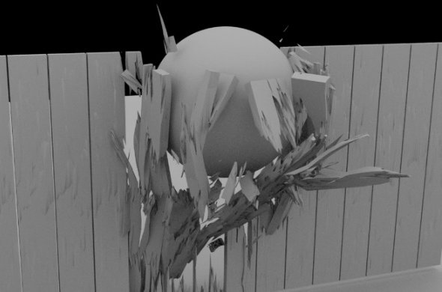
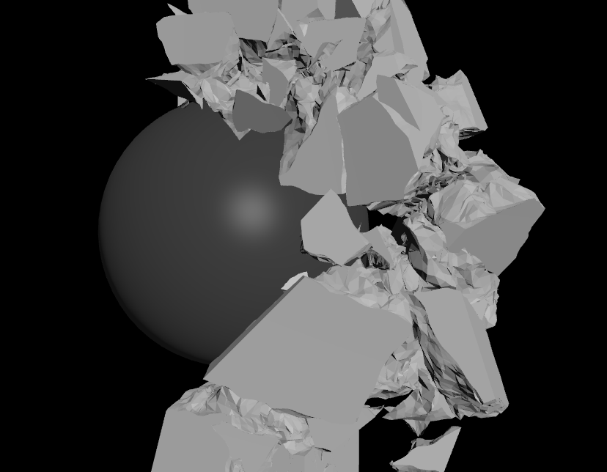
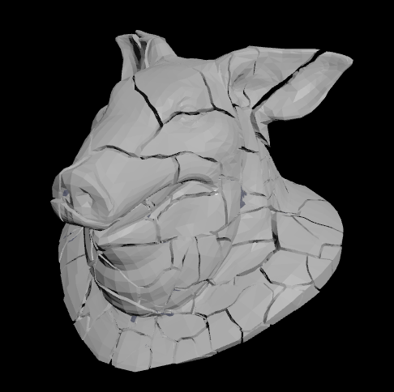
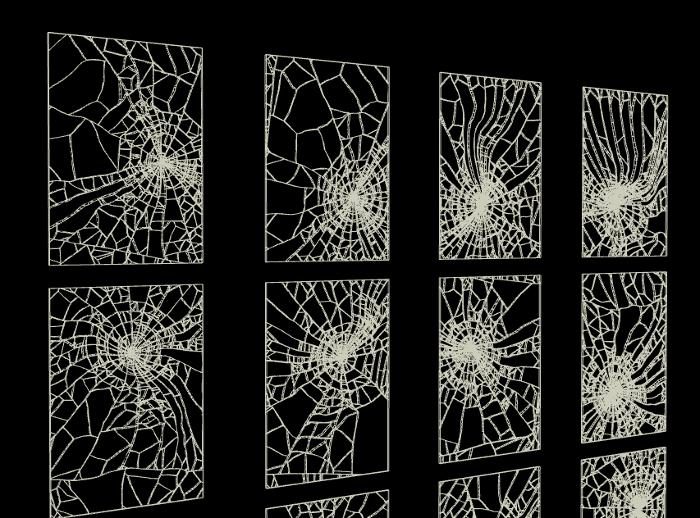
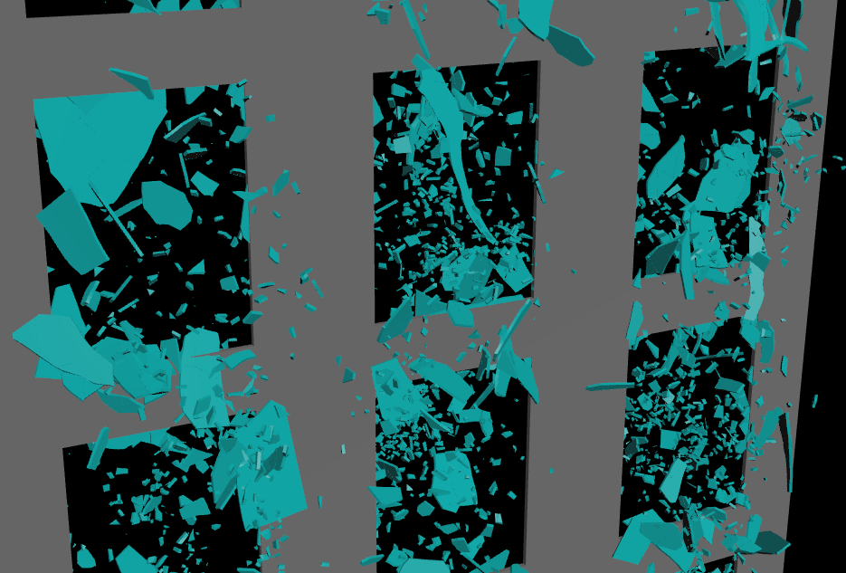

Slide 8

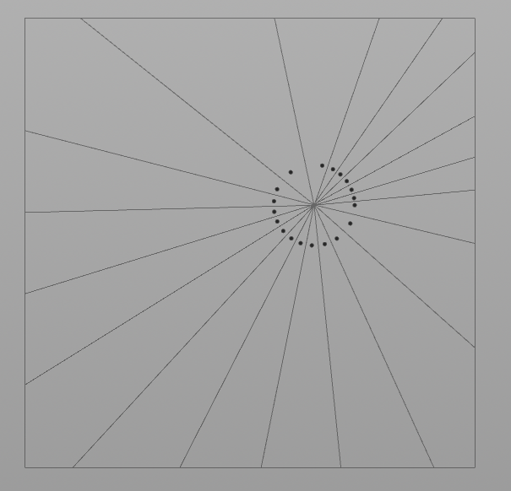
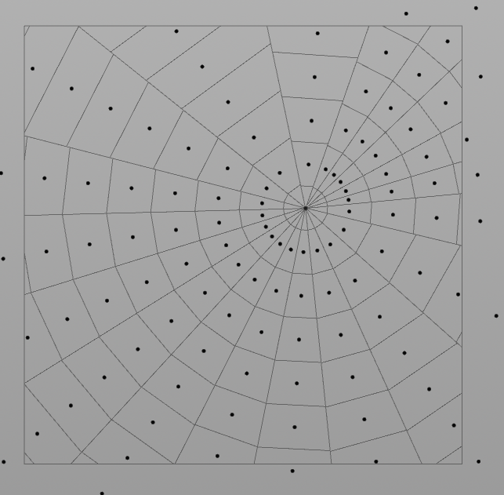
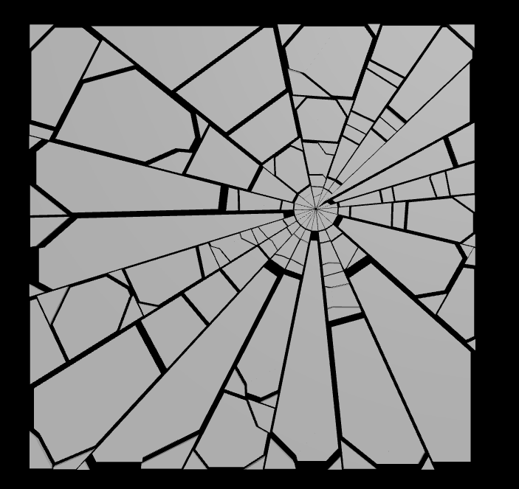
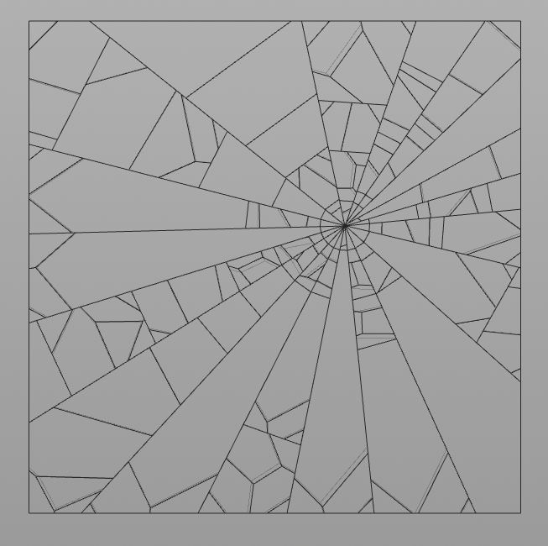
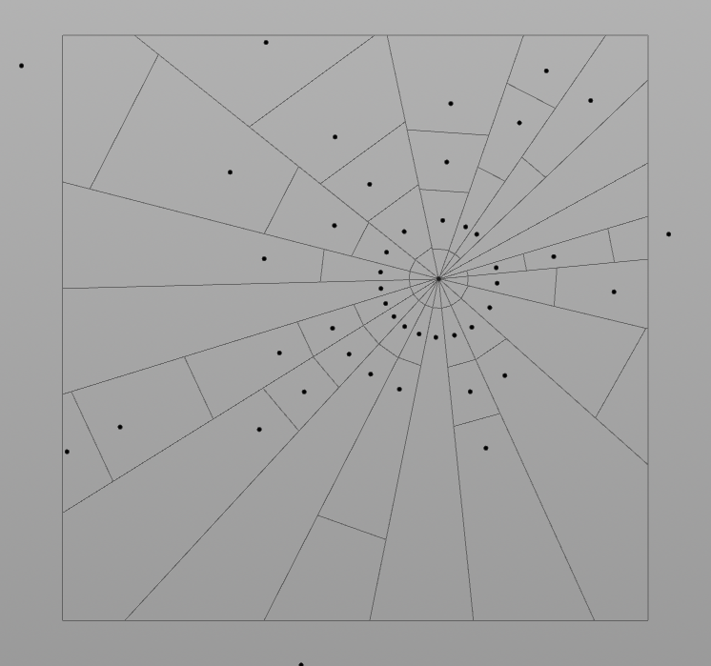
Glass Fractography
Impact Point
Radial Crack
Concentric Crack
Exploded
Chipping
Discontinuity

Slide 9
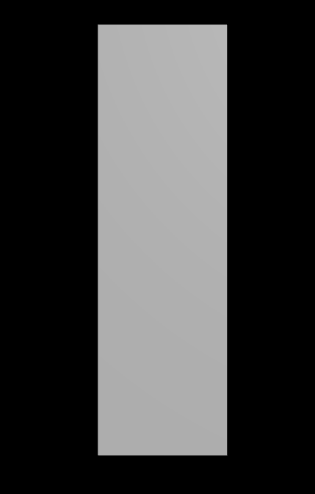
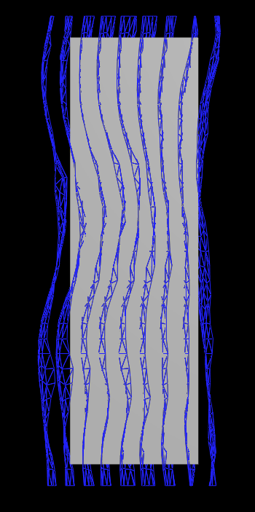
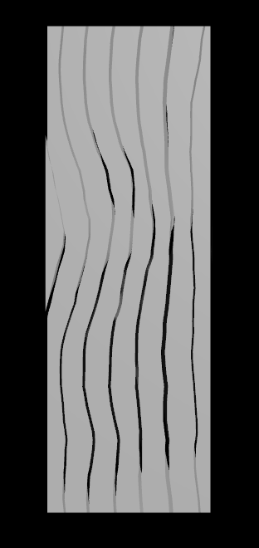
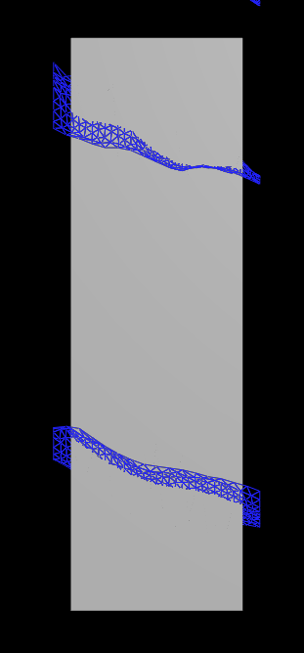
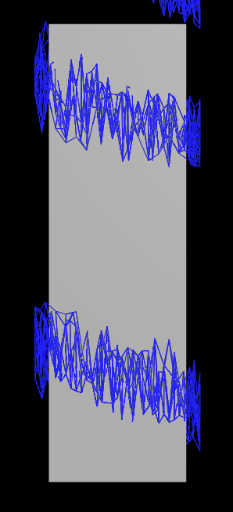
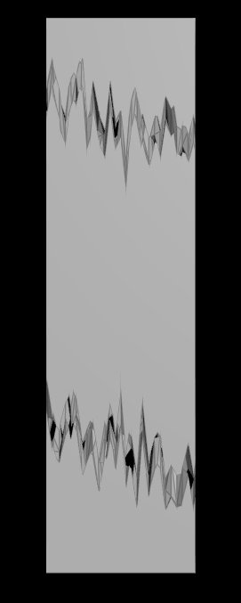
Wood Fractography
Grain
Cuts & Splinters

Slide 11
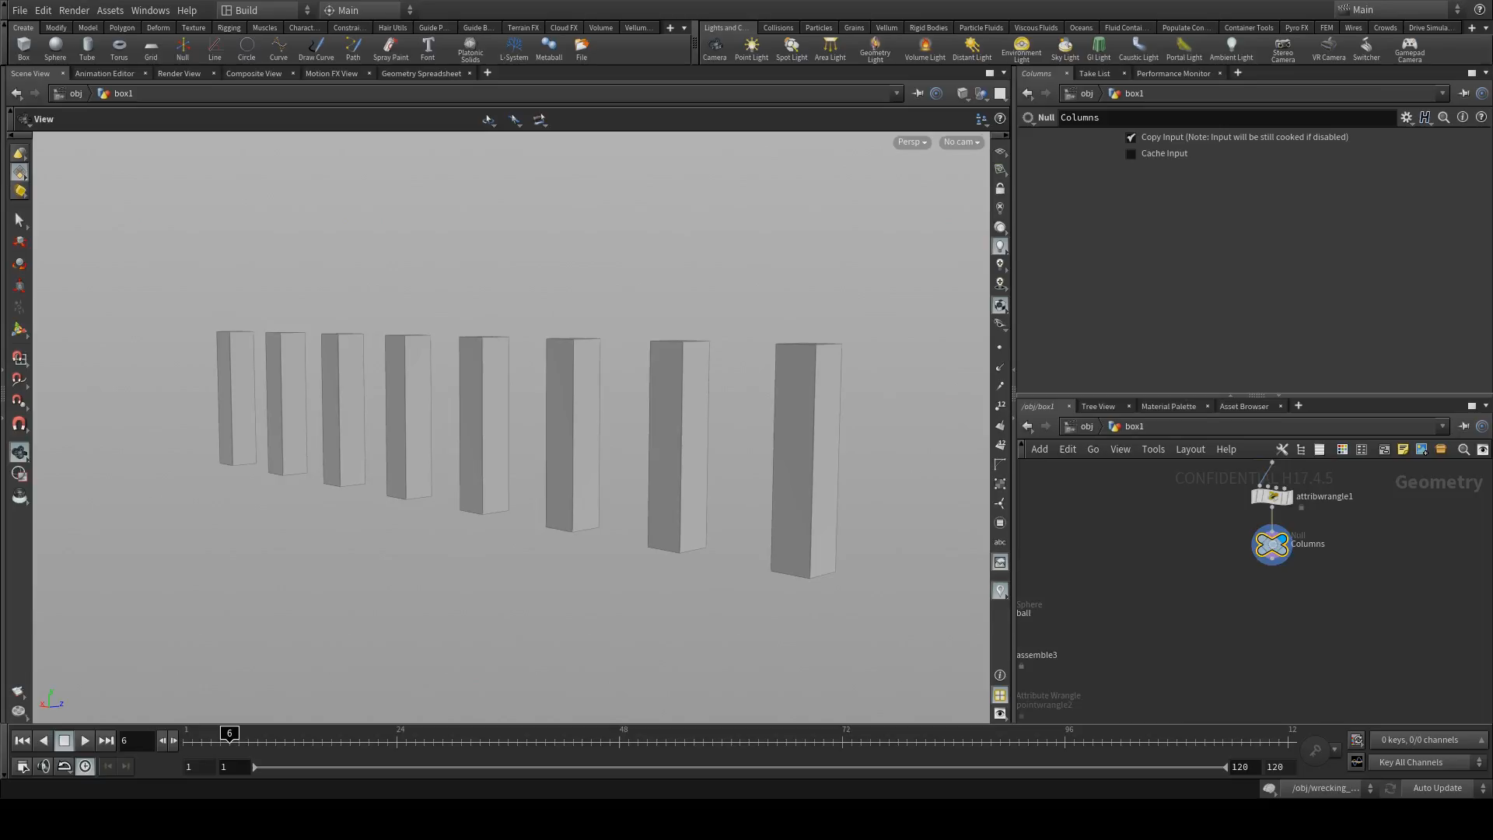
Concrete
Fracture

Slide 12
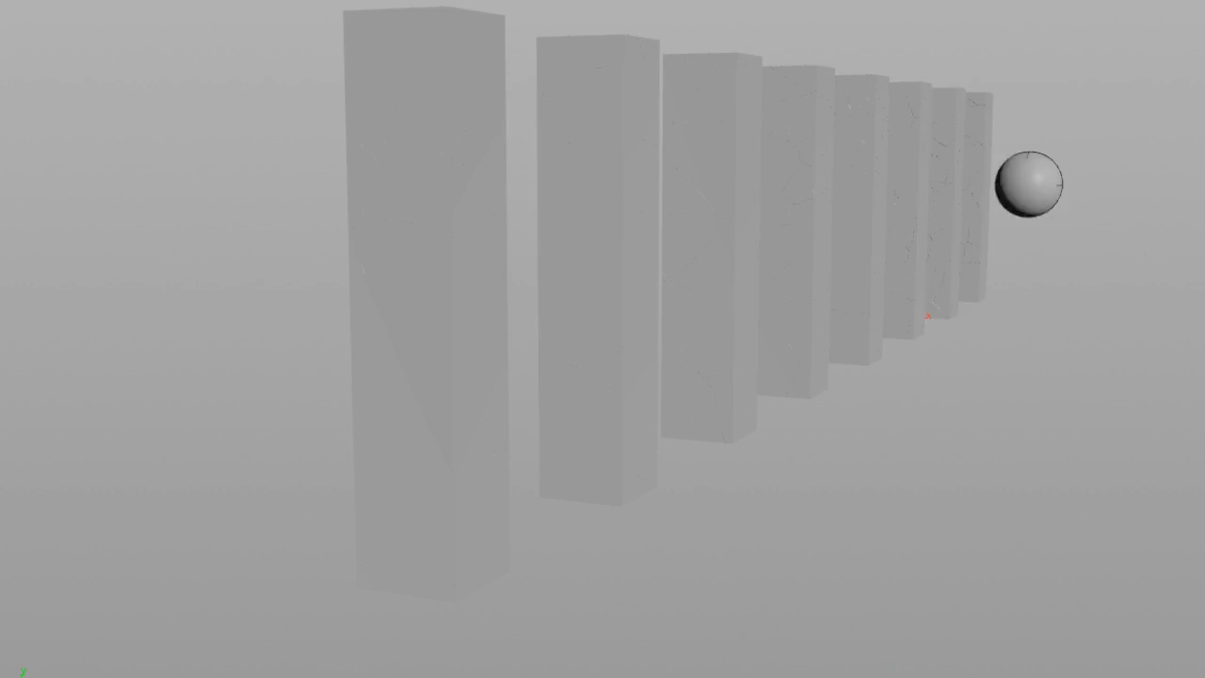
Concrete
Fracture

Slide 13
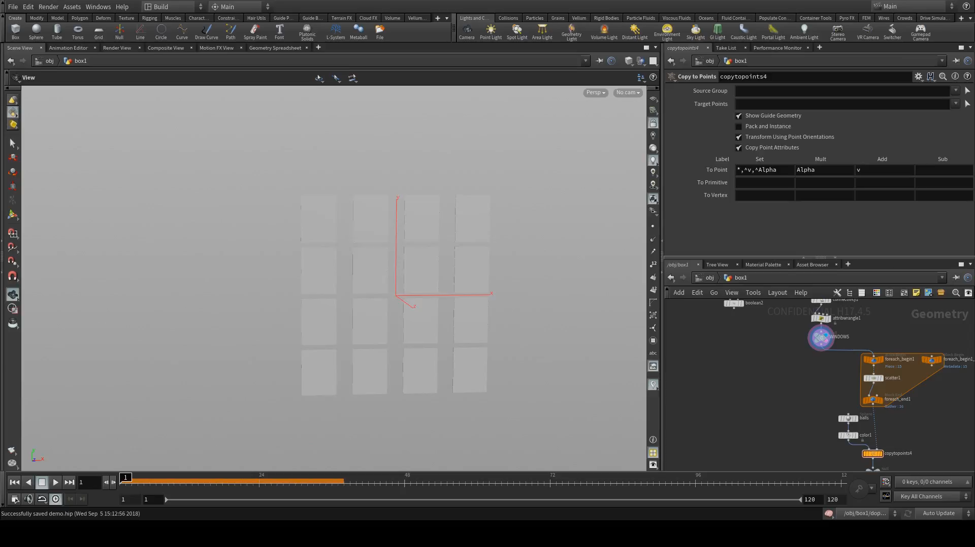
Glass
Fracture

Slide 14
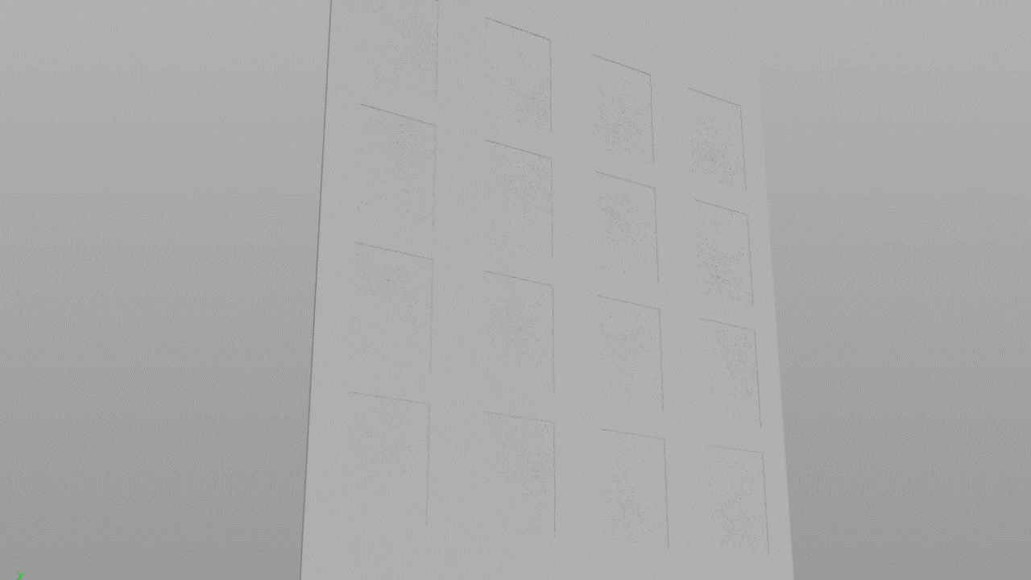
Glass
Fracture

Slide 15
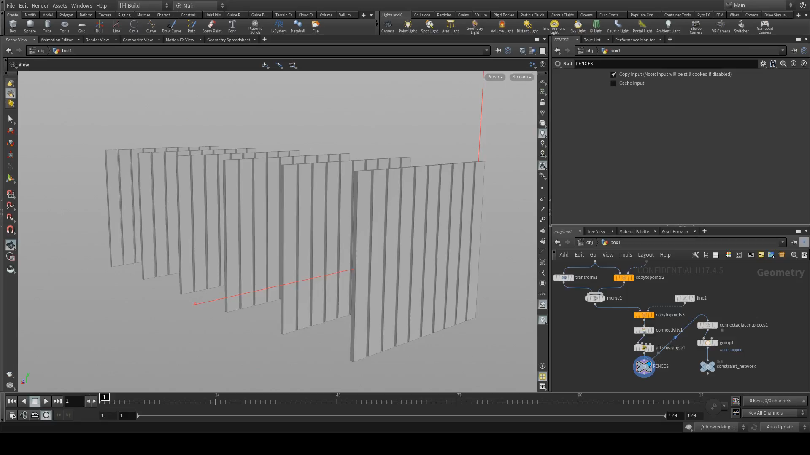
Wood
Fracture

Slide 16
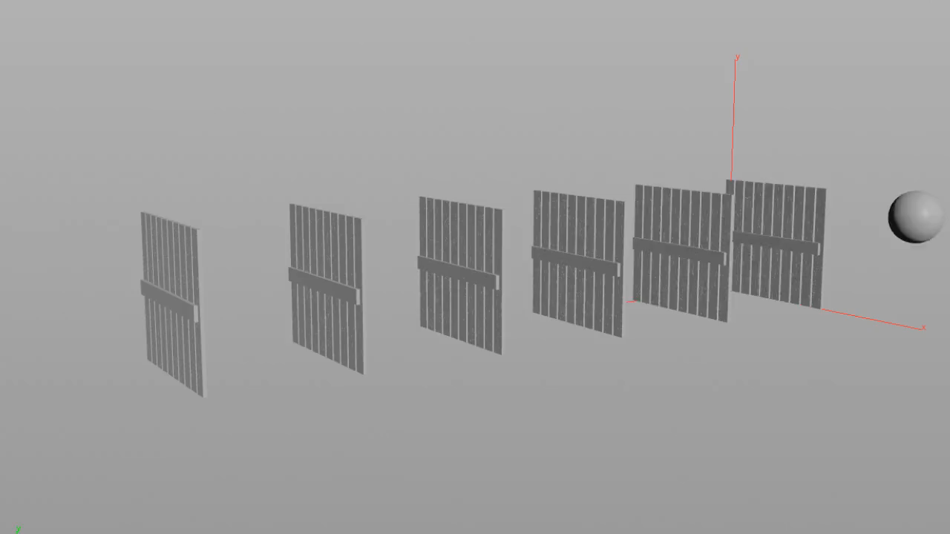
Wood
Fracture

Slide 17
Meet the RBD Family
RBD Pack
RBD Unpack
Geometry
Constraint Geometry
Proxy Geometry
RBD Recursive Fracture
RBD Material Fracture
RBD Paint
RBD Constraint Properties
RBD Cluster
RBD Interior Detail

Slide 18

Polymorphism
2.0
Voronoi Fracture
Boolean Fracture
RBD Recursive Fracture
RBD Concrete Fracture
RBD Glass Fracture
RBD Wood Fracture
RBD Material Fracture

Slide 19
Auto-Constraint Workflow
Pre-fracture Constraints
Fracture
Create Network
RBD Material Fracture
Isolate Groups/Types
RBD Constraint Properties
Assign Parameters
Post-fracture Constraints
Sim Ready!

Slide 20
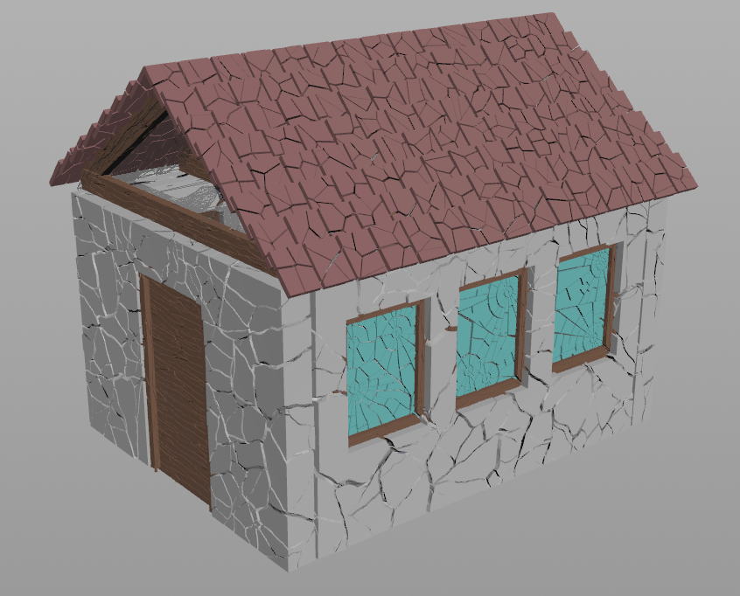
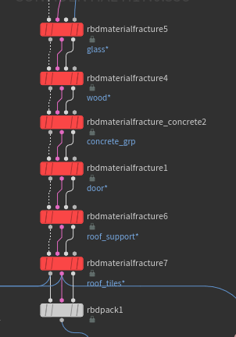
House Fracturing

Slide 21
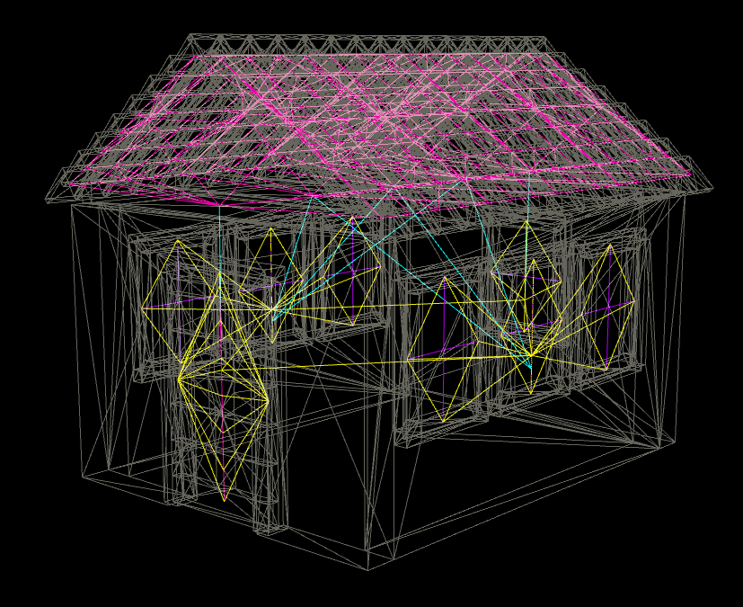
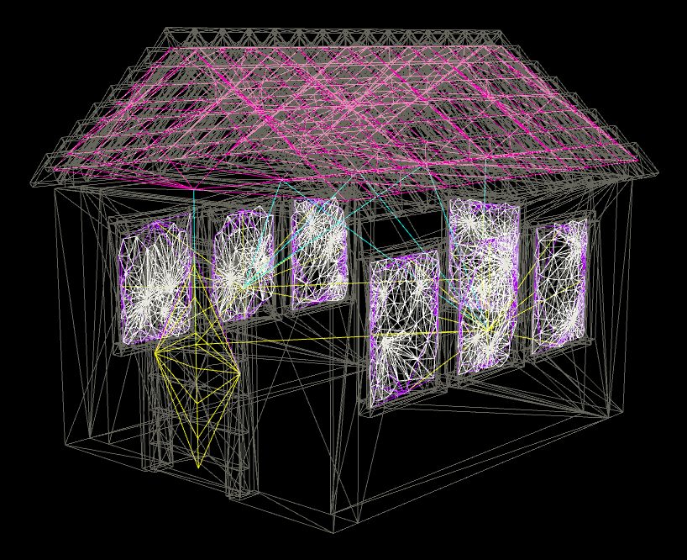
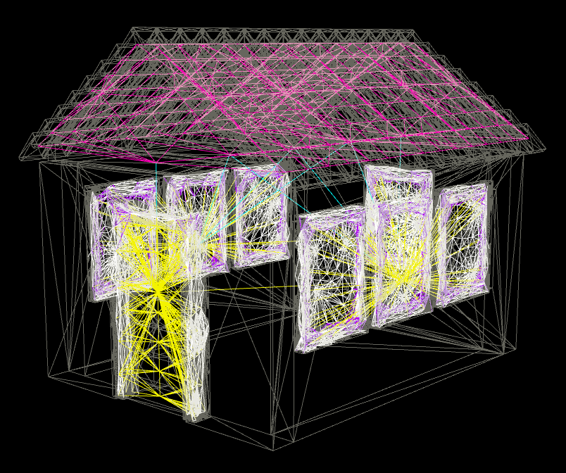
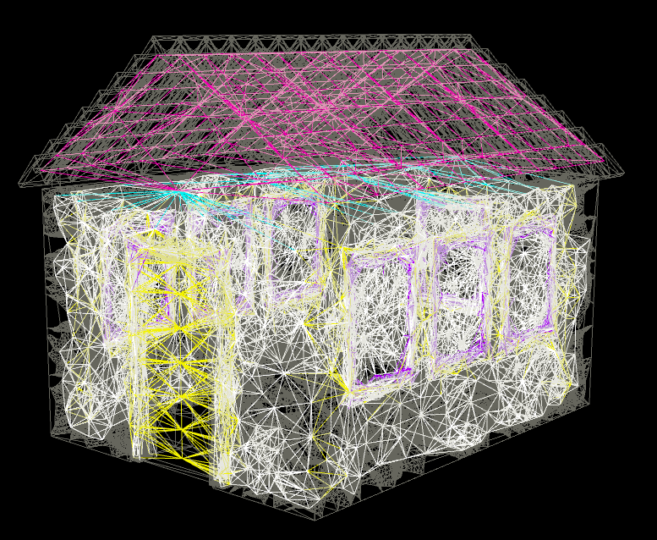
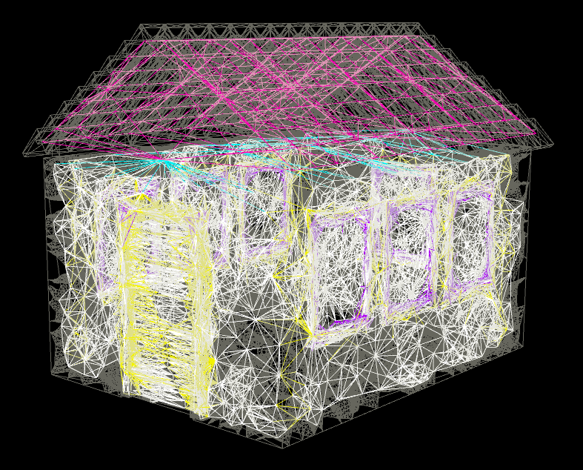
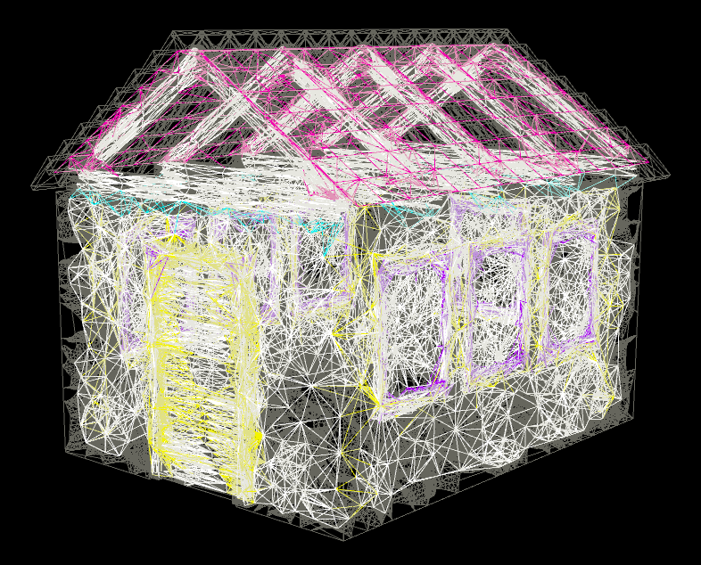
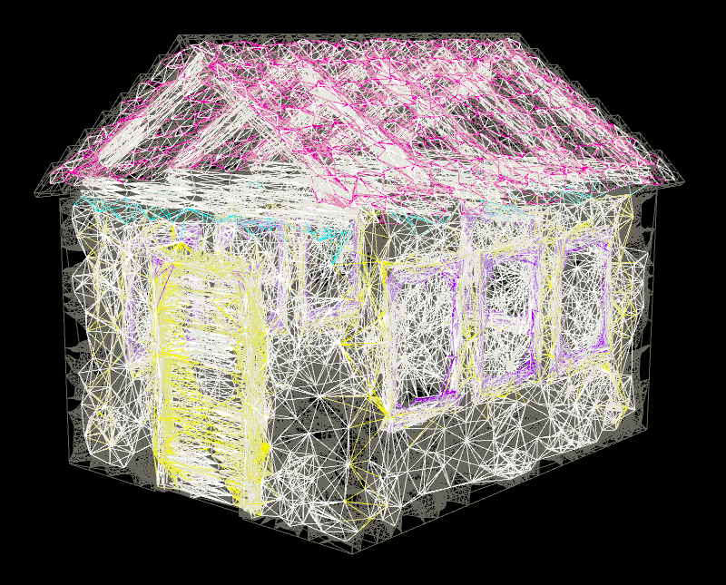
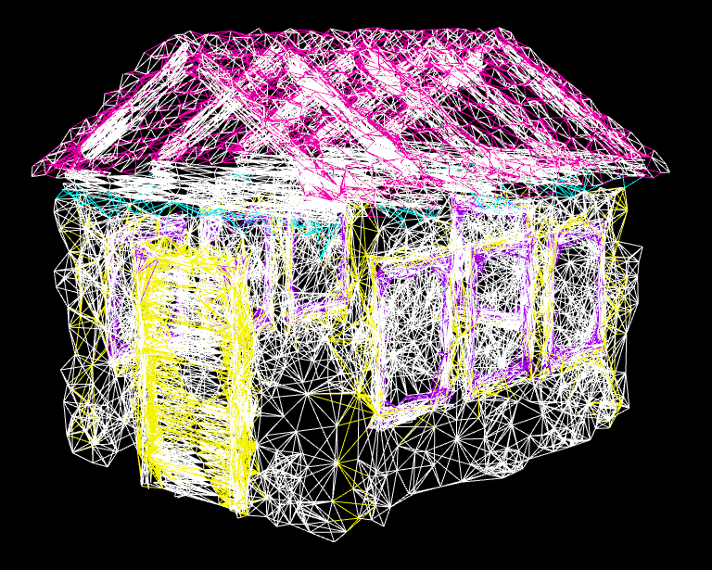
Original Constraints
Window
Wooden Frames
Concrete Wall
Wooden Door
Roof Support
Roof Tiles
Final Constraints

Slide 22
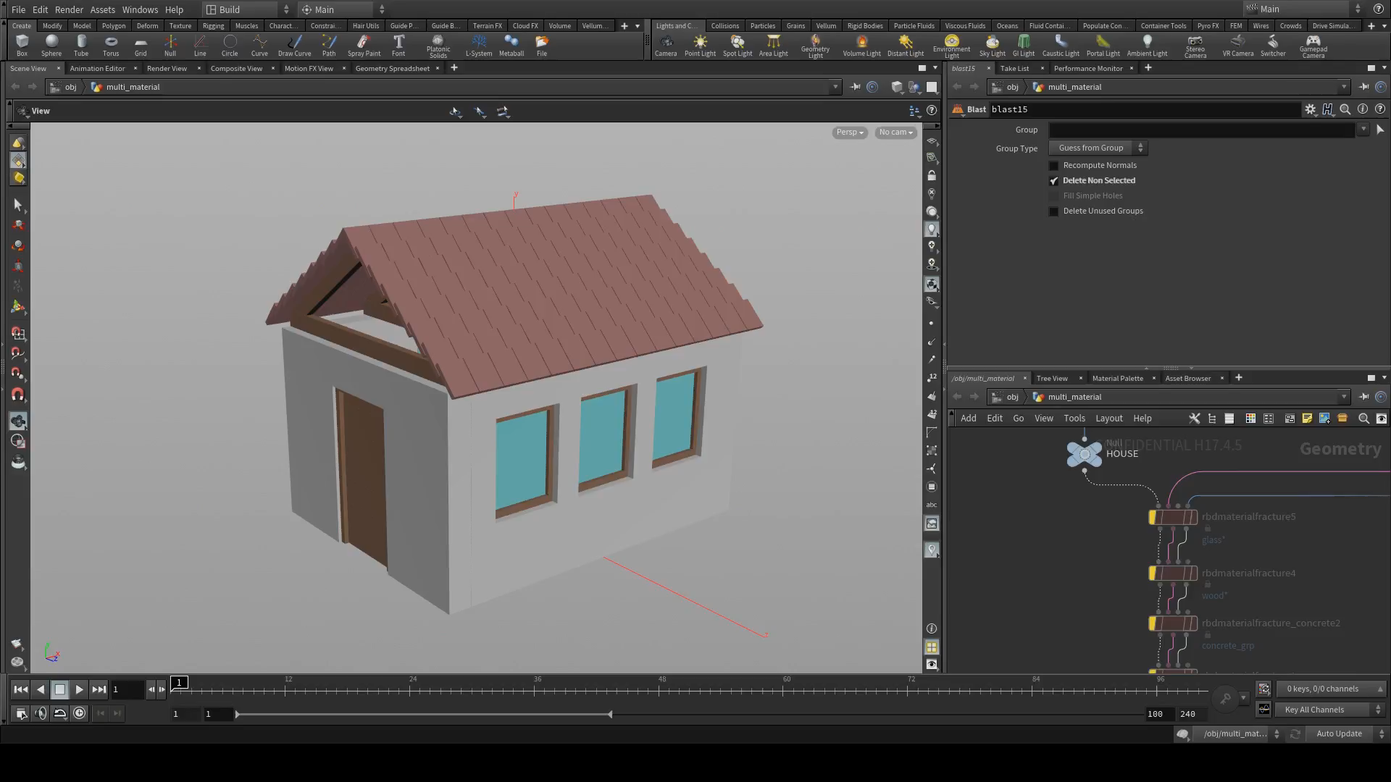

Slide 23
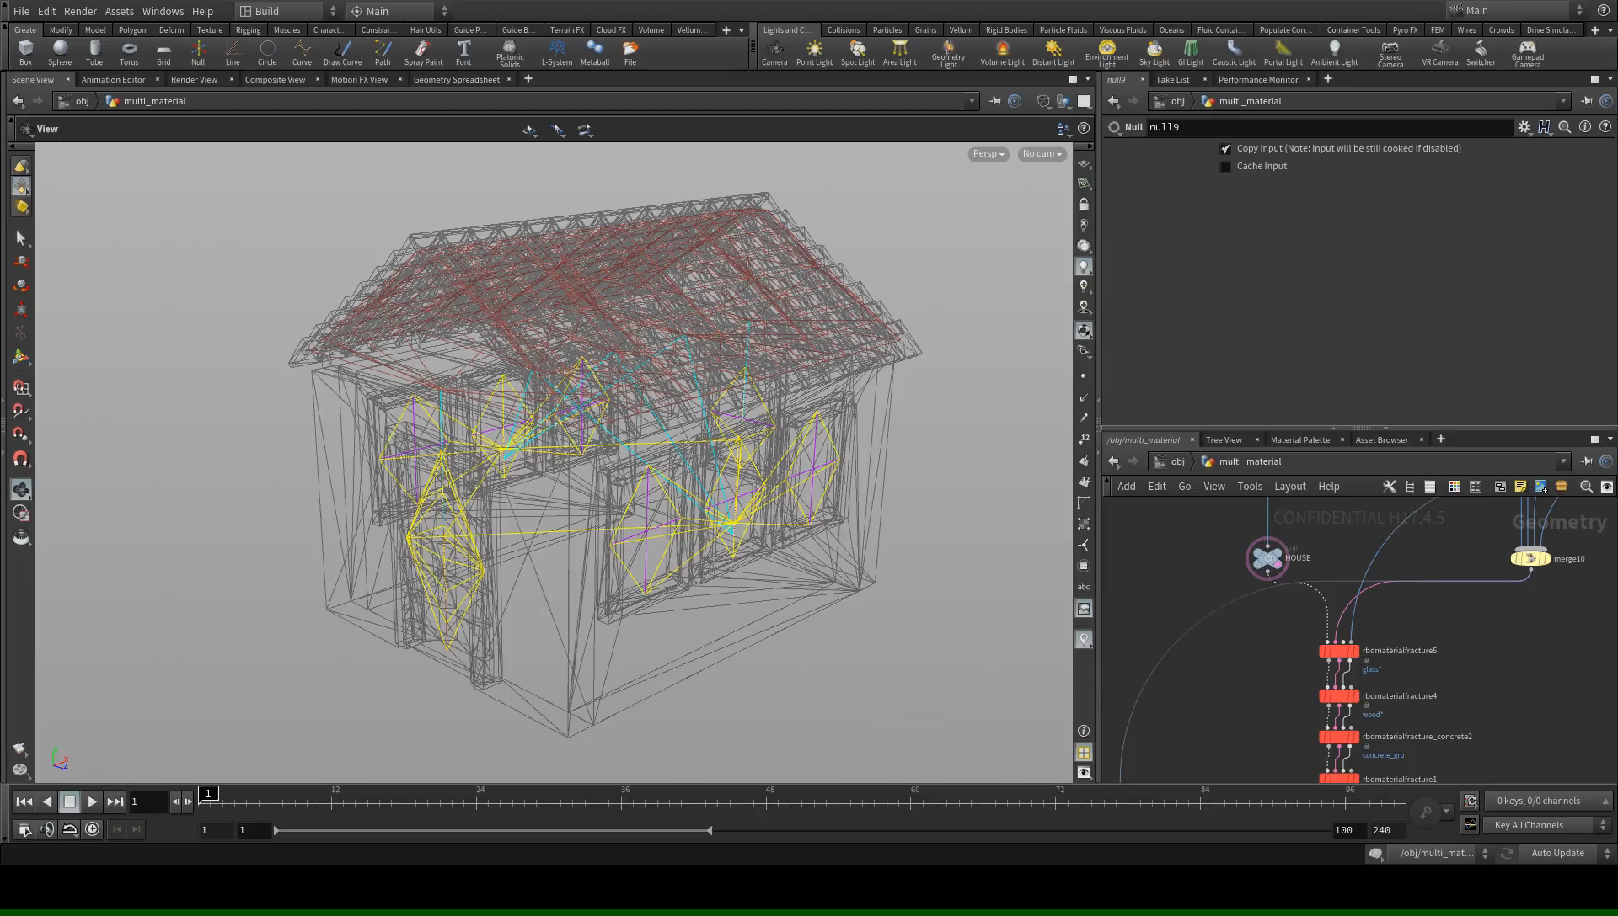

Slide 24
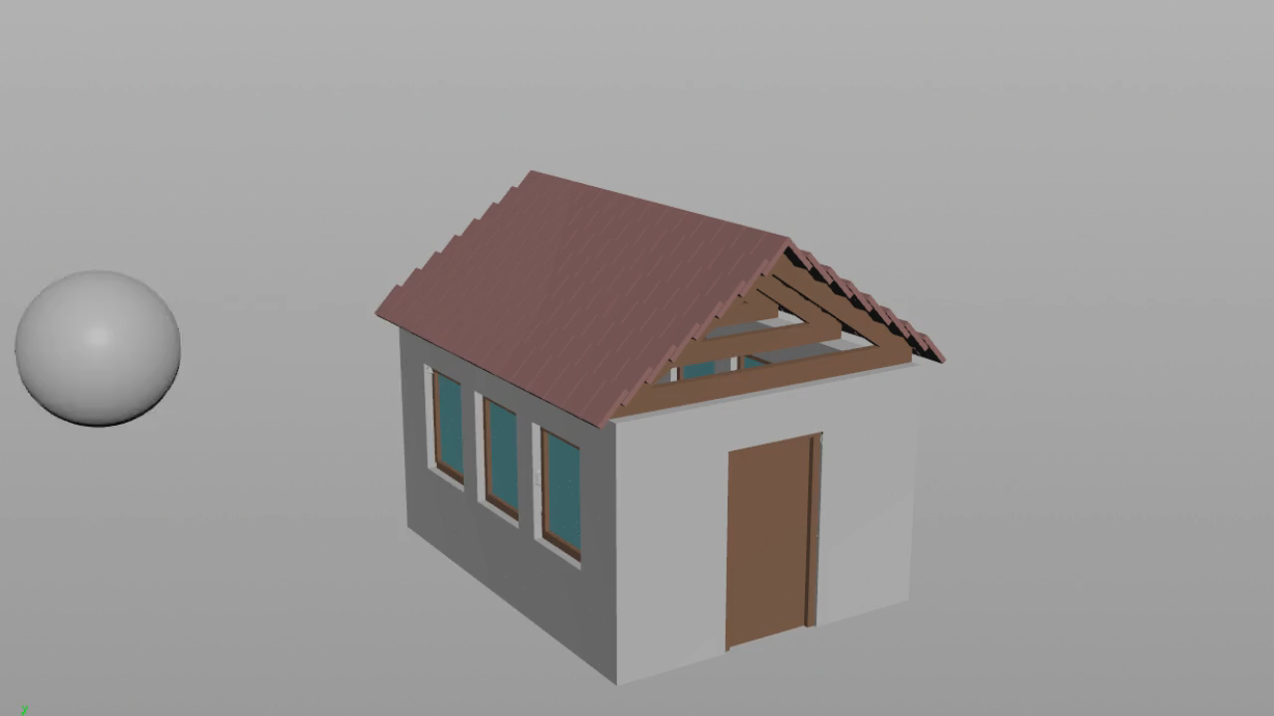

Slide 25
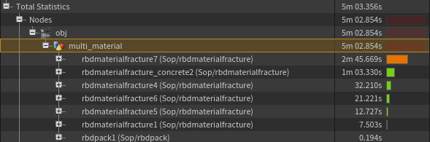

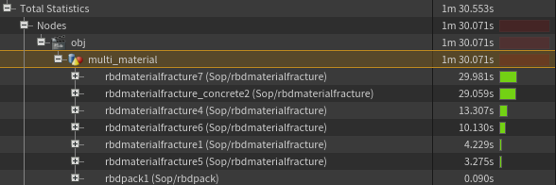
Everything Compilable
Not Compilable
Compilable

Slide 26
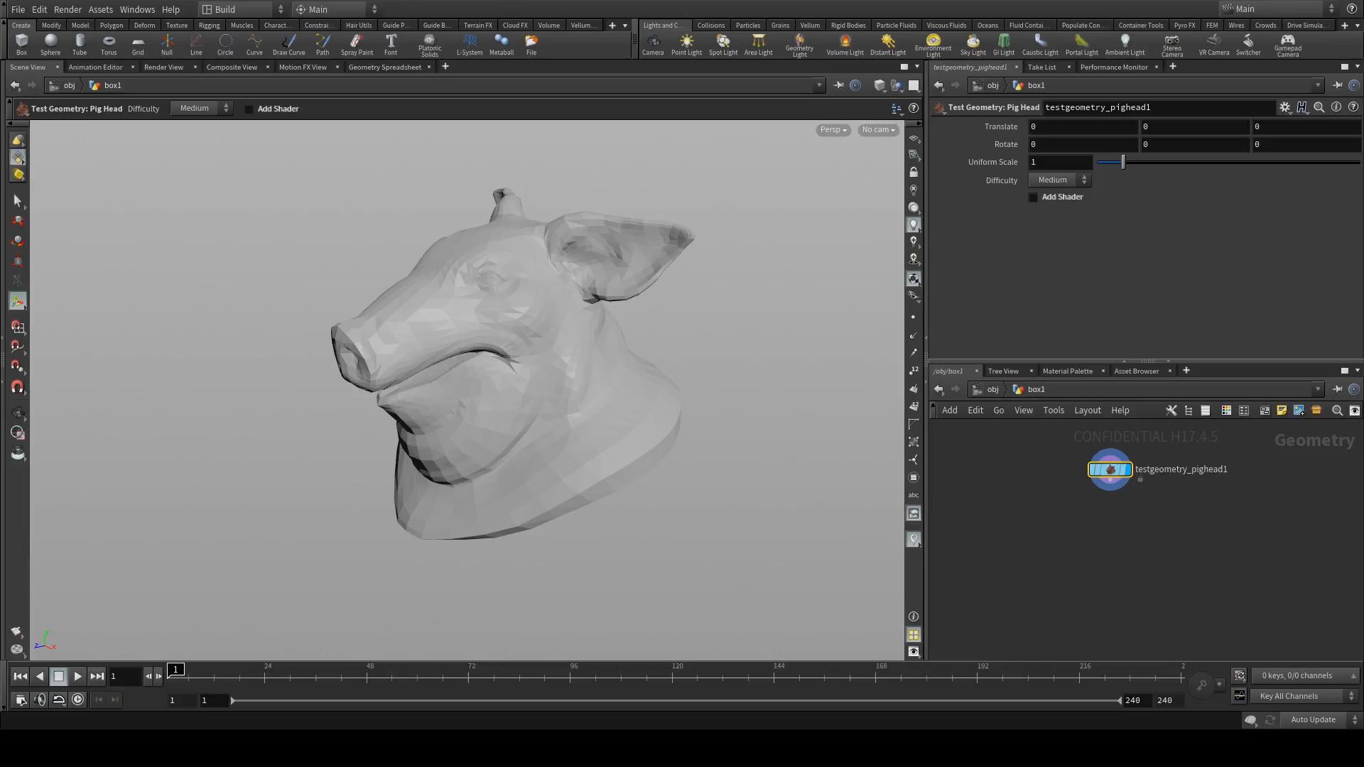
Attribute
Painting

Slide 27
This is just the beginning…

